Slide 1
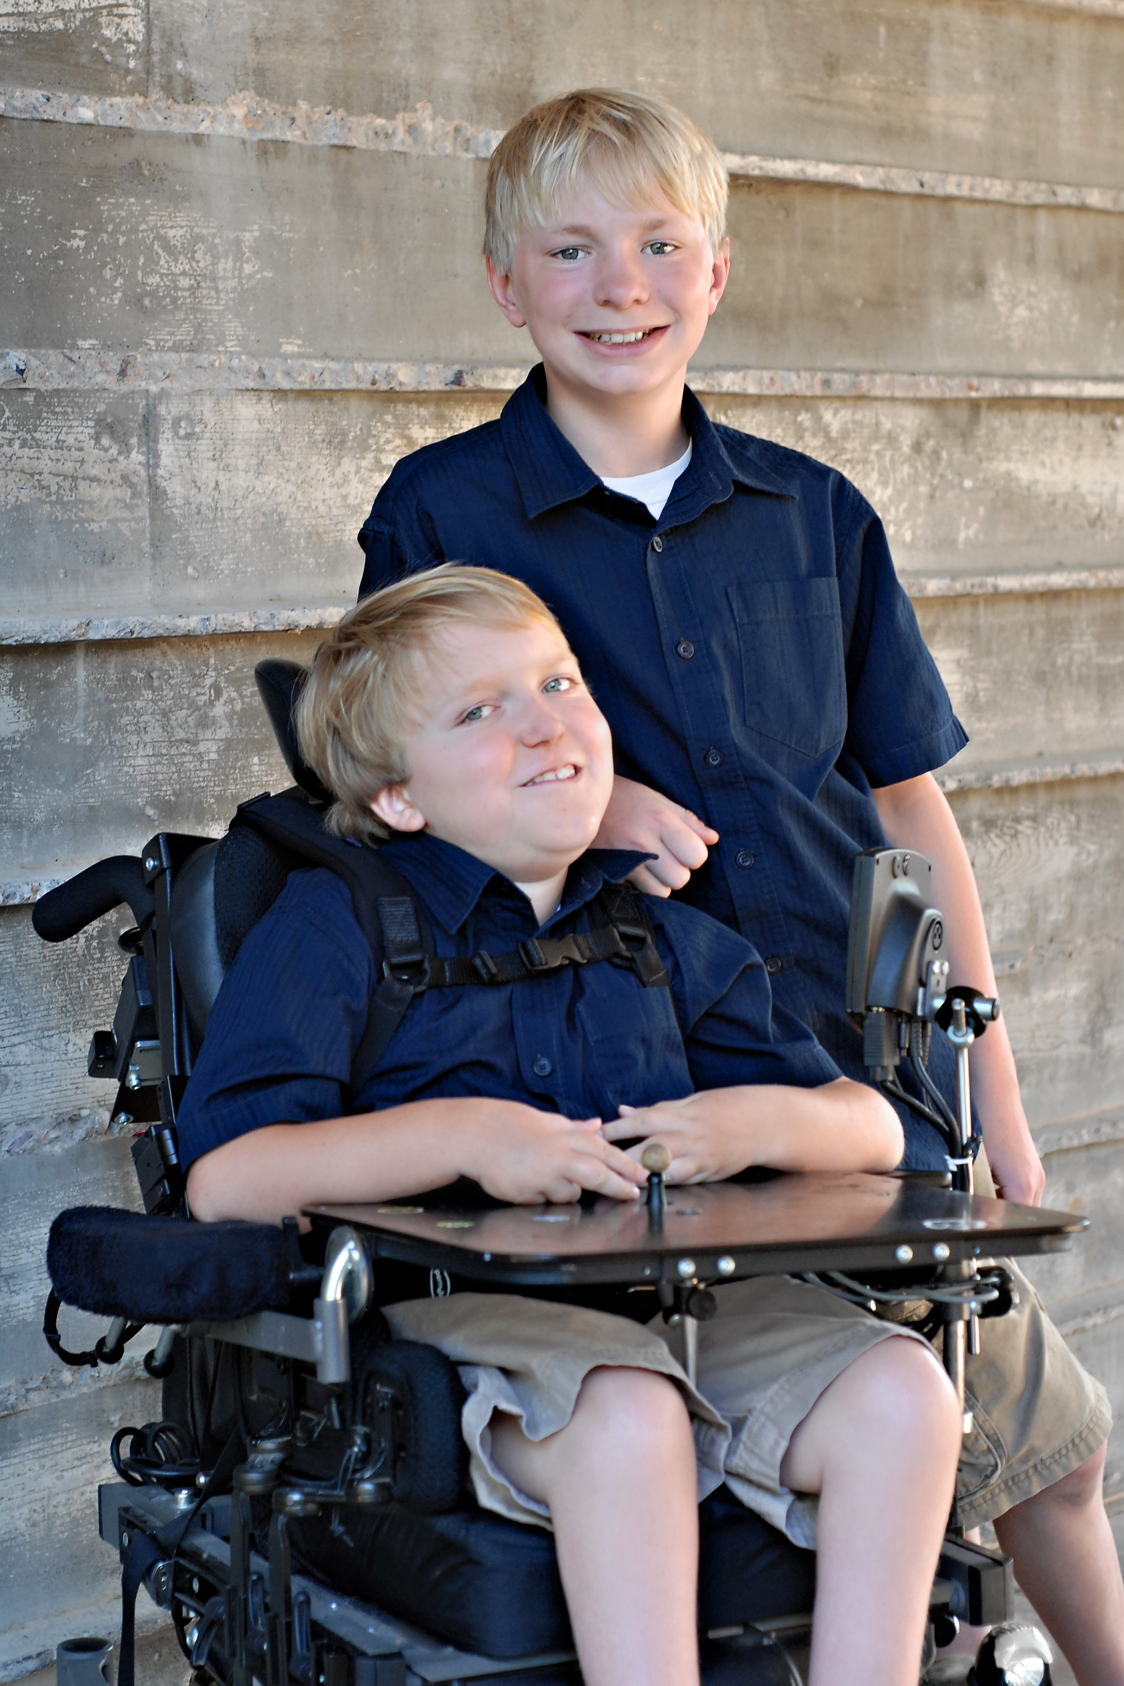
Notes:
Jonathan and I have two beautiful sons – Ethan is 13 and in 8th grade; Ryan is 10 ½, in 5th grade, and has “beaten the odds”. One of my favorite parenting quotes is this: “We do not HAVE children; we receive them” and we’d add, as many parents probably do,…”and with them, many lessons in life”! While Jonathan and I have our own ideas about living life to the fullest, Ethan and Ryan have taught us much more! Like many children, they have a few ideas of their own about living life to the fullest, so I’d like to briefly share a “day in the life” of two brothers…

Slide 2
What’s Really Important in the Mind of a Child…
Daily Routine | Ethan – By Himself | Ryan (w/ Adult) when he’s well
Get Up | -- | --
Chest Vest | -- | 15 minutes
Get Dressed | 3 minutes | 10 minute
Brush Teeth/Hair Comb | 3 minutes | 5 minutes
Eat Breakfast | 10 minutes | 30 minutes (w/ medicines)
SCHOOL
Afternoon Snack | 5 minutes | 15 minutes
Homework | 60 minutes | 75 minutes
Shower/Bath | 10 minute - Shower | 45 minute Bath (w/ Lift)
Toileting | 5 minute | 20 minutes (w/ Lift)
Dinner w/ Family | 30 minutes | 60 minutes (w/ medicines)
Evening Chest Vest | -- | 15 minutes
Get Ready for Bed | 3 minutes | 15 minutes (AFO’s, BiPAP)
DAILY ROUTINE TOTAL | 129 MIN | 305 MIN
REALITY: RYAN HAS 176 FEWER MINUTES AVAILABLE FOR VIDEOGAMES!
EVERYDAY…Not just once a week. 5+ hours a day =
OVER 1800 HOURS a YEAR
Notes:
I want to share this comparison of two brothers, not to promote the use of video games in a respite program, but to give a snapshot of just one day in the life of a child with a life-threatening condition. The care is often intense; it is daily and around the clock; many MORE families have MUCH higher care needs for their child or children than Jonathan and I have with Ryan – perhaps managing tube-feedings, monitoring ventilator settings, suctioning secretions and airways, providing tracheostomy care, ongoing assistance with daily living, and much, much more…
It is these needs that bring us to Day 2 of the Many Faces of Respite!

Slide 3
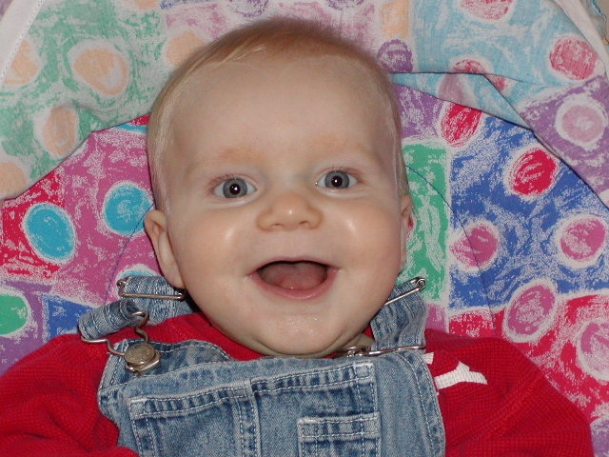
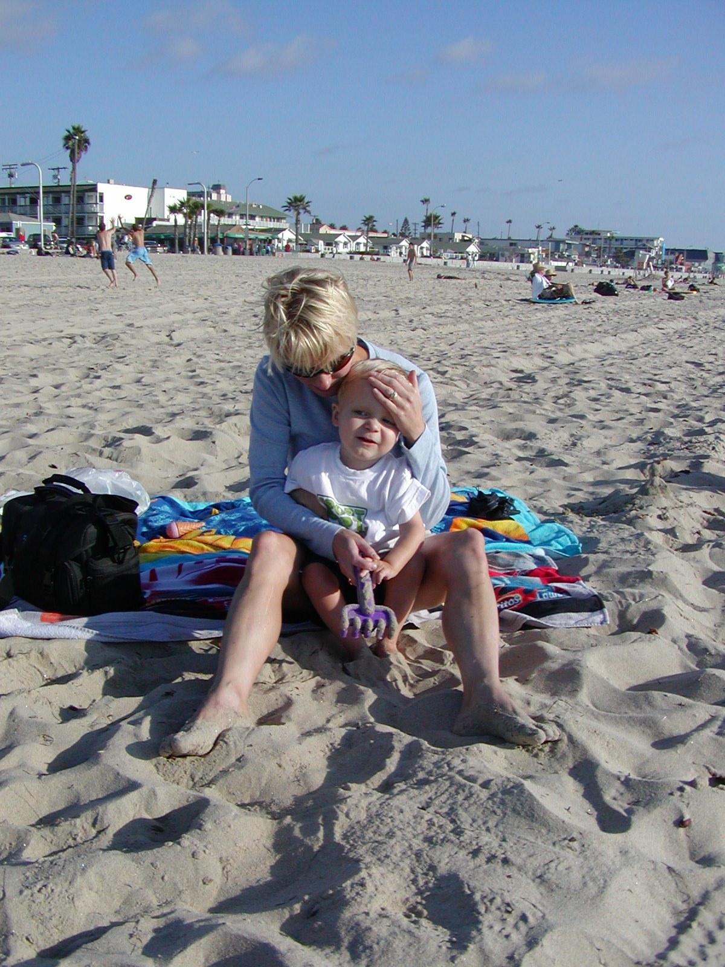
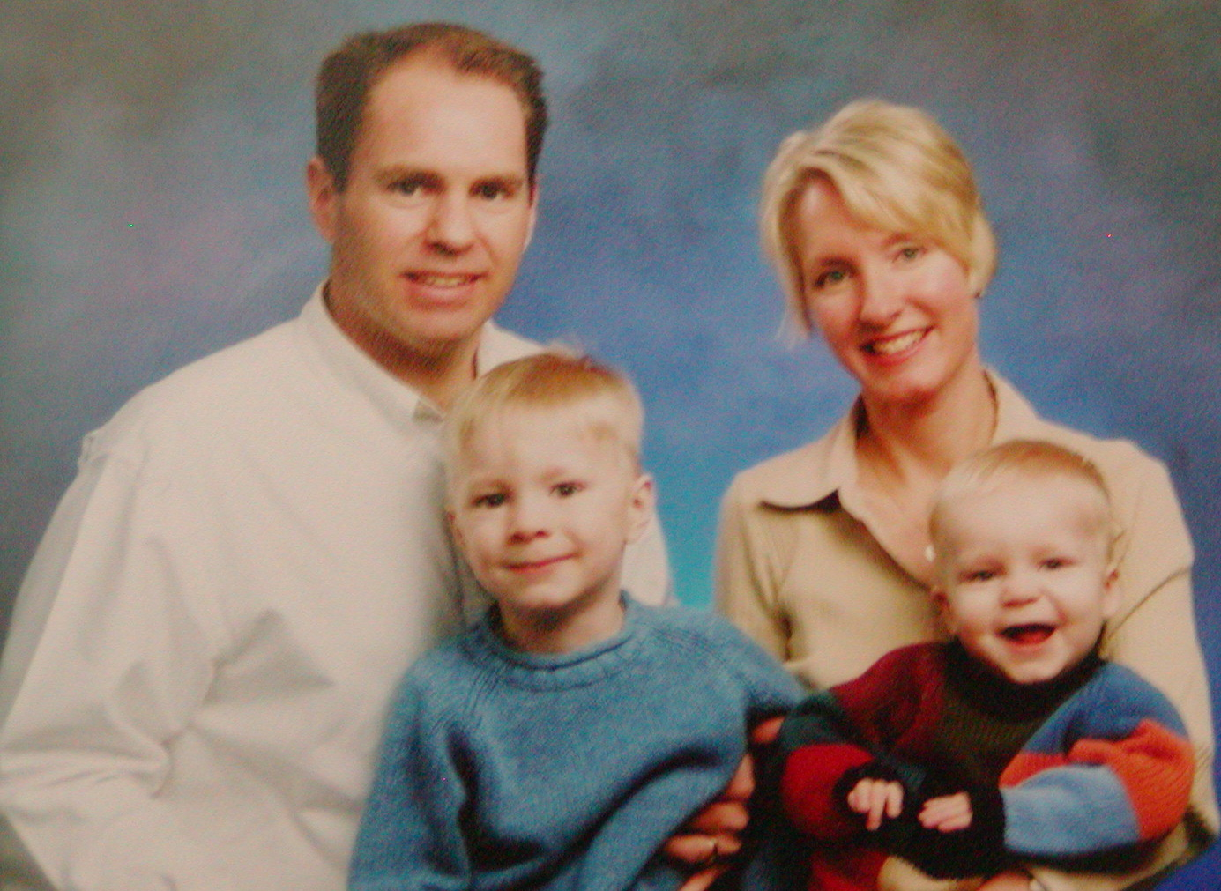
The Many Faces of Respite
Notes:
Good morning and welcome to day 2 of The Many Faces of Respite
We’re here as parents who benefit from respite and as part of a unique caregiving model for children and families in AZ – Ryan House.

Slide 4
Objectives
  Keep pediatric respite programs top of mind!
  Recognize your community’s potential
  Take action in your community
Notes:
Our objectives are for you to be able to:
Keep children and pediatric programs top of mind when providing/developing lifespan respite programs: Differentiate a pediatric palliative and respite care concept from currently available programs/services
Recognize your community’s potential: If our community could do this, so can yours! As part of the Network Building track, our goal is for you to discover similar network building opportunities.
Apply development/support a developing program in your community!!
Since August of 2004, when Ryan House incorporated, Jonathan and I have often said that “the stars were aligned” for Ryan House. This morning, I will share a bit of the background of Ryan House and Jonathan will highlight how networking brought the project from dream to reality!
Before I dive into the background, I’d like to start by thanking YOU for the work you do in your own communities to further lifespan respite services and meet families’ needs.

Slide 5
When stress is colossal…
“… the grinding stress of caring for a loved one with a terminal disease is common to families…”
“Isolation can be deadly.”
“It’s so important for people to get help and get help early.”
Halverstadt, L., & Wright, L. (2011, September 25). Some link Alzheimer’s to tragedy at Luke. Arizona Republic, p. B1.
Notes:
Here in Arizona, we were recently reminded of the immense strains that caregivers face and the toll those stresses can take. In this particular situation, a husband caring for his wife with Alzheimer's did not receive the respite support over time he so desperately needed… and the result ended tragically. Even though this incident highlighted a husband caring for his wife, the reality is that those stresses are universal in many caregiving scenarios – caring for a parent whose health is declining or for a child who has a life-limiting or life-threatening condition. In our presentation today, we’re going to share how Ryan House is addressing this need for children with life-threatening conditions in Arizona and how similar programs developing in the U.S. will provide similar essential care…

Slide 6
Caring for children with life-threatening conditions
Approximately 400,000 American children
Impact on families
Notes:
In the U.S., approximately 400,000 American children live every day with chronic, life-threatening conditions.
Families caring for children with life-threatening conditions - often 24 hours a day over many years - can feel extremely isolated and under enormous emotional, physical and financial strain: relationships can suffer with up to 90% of marriages ending in divorce; careers may have to be abandoned; well brothers and sisters feel left out, with 85% experiencing academic, emotional, and behavioral difficulties; and typical family activities become impossible.
Homes like Ryan House welcome whole families for respite care, giving them a break together or time to themselves in a comfortable home-like atmosphere, and support throughout their child’s lifespan.
Why is this particularly important for children?

Slide 7

Notes:
Just recently at Ryan House, a little boy came who had nearly died several days before. He was initially diagnosed in August with a malignant tumor of the nervous system. Two days before he came to Ryan House, he had been admitted to the hospital and seemed to be actively dying. He stabilized, went to Ryan House for end-of-life care, and seemed to have a turn-around… enjoying macaroni and cheese, ice cream, and crazy hat day. What this illustrates is the unpredictability parents (and even care teams) often have when caring for a child with a life-threatening condition. Childhood conditions or illnesses often follow a very different course than that of adults… they may do well for a long time and then quickly decline; they may have many ups and downs, nearly dying and then bouncing back, and so on. The unpredictability and roller coaster of care, often coupled with high care needs, means that parents or families can’t just arrange for the local neighborhood babysitter to look after their child…
Our family’s roller coaster of care, in hindsight, really started the first week of our younger son Ryan’s life. His great grandmother had said, “Tell his big brother that Ryan will say ‘I love you’ by grabbing on to his finger… eventually he’ll sit by him to say ‘I love you’, then he’ll crawl by him, then he’ll walk, and then he’ll run. When Ryan wasn’t able to grab on to his brother’s finger, we just imagined he was a late bloomer…
But when he wasn’t rolling at 5-6 months and wasn’t sitting by 8 months, we became more and more concerned and wanted to know how we could help him.

Slide 8
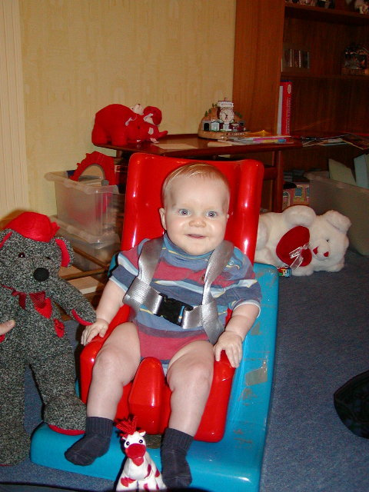
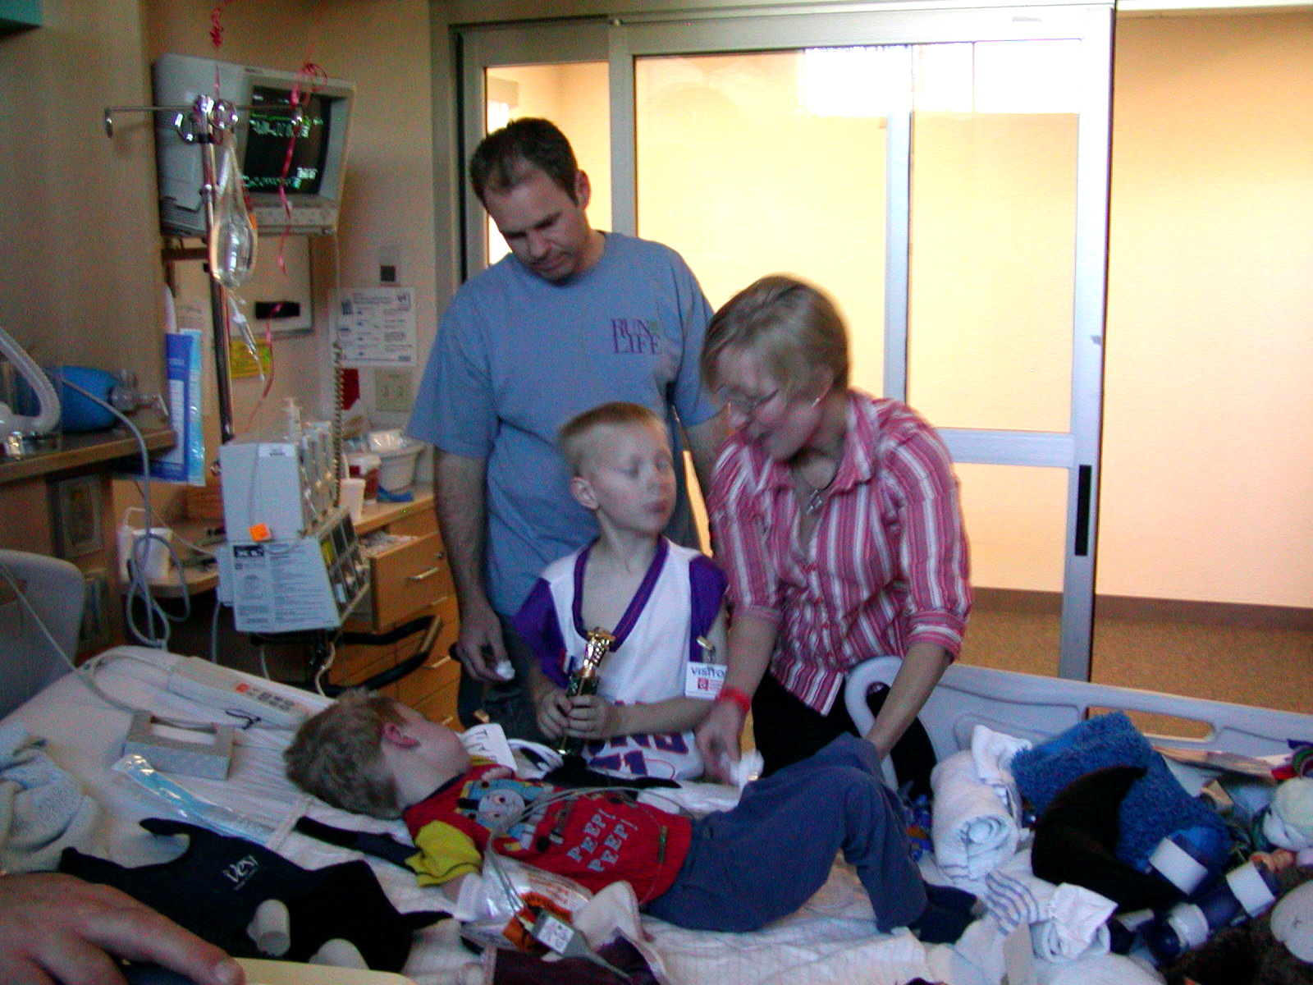
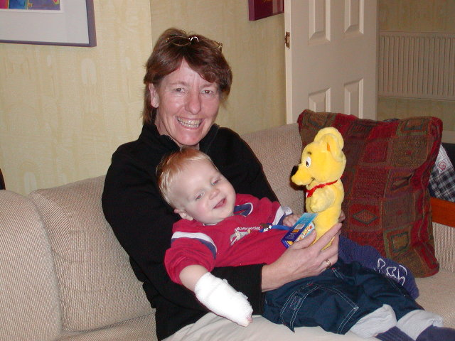
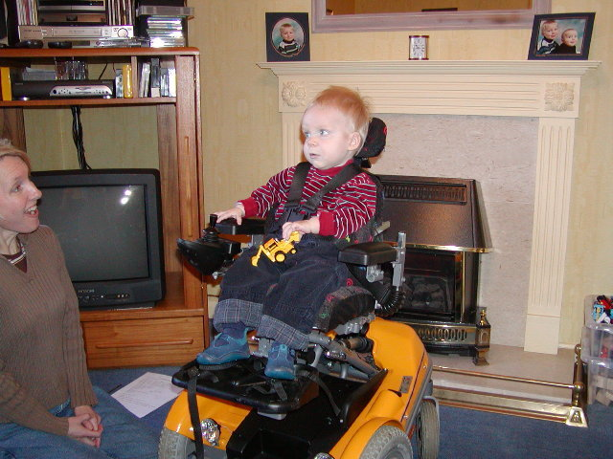
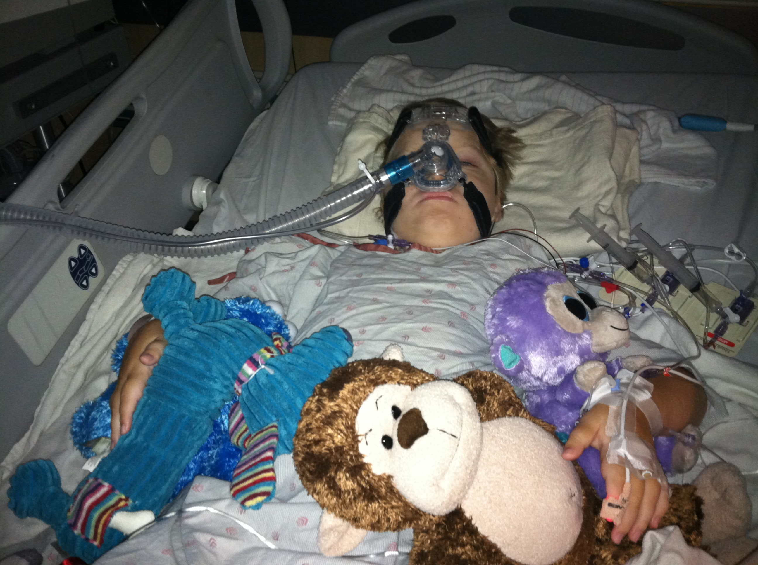
The roller coaster of care…
Notes:
On February 14, 2002, we carried our almost 10-month old son into the neurologist’s office to learn results of genetic testing from the month before. We took our happy, and in our minds “healthy” baby, into the appointment without so much as a cold, and left with the devastating news that he would likely not live long into childhood. We learned that up to 80% of the children with the most severe form of his disease – spinal muscular atrophy – do not survive to their 2nd birthday. We had to shift our thinking from how we would provide a life without limits for a disabled child to how we would live with his limited life.

Slide 9
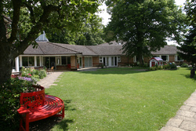
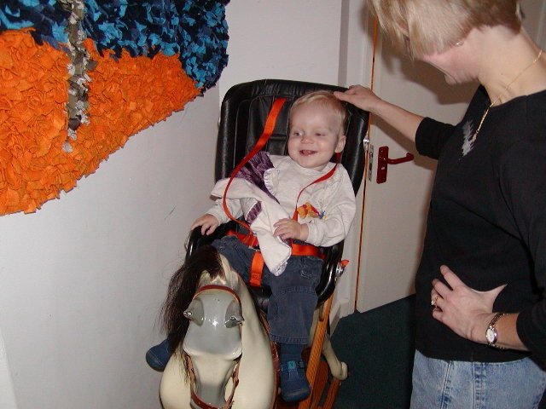
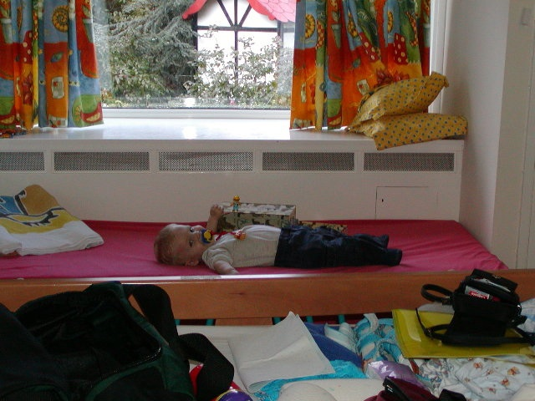
We didn’t know about “care” until we needed it!
Helen House, Oxford, England
Notes:
Although Jonathan and I are native Arizonans, we were living in England for Jonathan’s career when Ryan was born and diagnosed. We didn’t realize at the time, but we were in a country that has led the development of pediatric palliative and respite care for over twenty-five years.
Each of us had zero experience with “respite” care and had not even heard of pediatric palliative care, when Ryan’s physiotherapist said, “There’s a children’s hospice about 30 minutes away in Oxford. I haven’t been, but I’ve heard it’s really lovely. Ryan will receive excellent care and you and Jonathan can spend some time with Ethan or even have time together.”
Our prior knowledge of hospice brought forth images of not only older adults, but older adults who are dying. We knew our son’s prognosis was poor, but thought, “Why would we take him to a hospice? He’s doing well now and he doesn’t seem anywhere close to dying.”
However, several months into caring, and desperate for a full night’s sleep alone, we were ready to have a look at Helen House. It only took one visit for us to realize that this “hospice” was more about living than dying – and could be a wonderful resource for our family.
We enjoyed two respite stays as a family at Helen House and had Ryan stay on his own while we packed to return to Arizona in the spring of 2003. We were eager to learn from Helen House during our last couple of visits about similar programs in the United States. We were heartbroken when we learned that only one program – George Mark Children’s House – was in the process of developing, but was not even open yet.

Slide 10
“We have a wonderful problem”
“We are keeping children alive longer.” - Susan Levine
Cabot, V. (2006, January 20). Ryan House to offer ‘comfort care’ for sick kids. Jewish News of Greater Phoenix, Tevet 20 5766.
…and at the same time, community said…
‘I can’t believe something like this doesn’t already exist!’
Notes:
A little bit later, Jonathan is going to share the many aspects of networking that solidified the development of Ryan House, but I’d like to highlight one of the first.
When we moved back, we were fortunate to share our family’s experiences at Helen House with a close family friend, Diane Eckstein, who in turn introduced us to Susan Levine, the Executive Director of Hospice of the Valley.
Early in the development, Susan reminded the community of this wonderful problem we have. In our country and culture, children are not supposed to die! With medical and care advances, many children with life-threatening conditions who would have died very early in their lives are living longer and longer, and often still with a focus on quality of life. For those children and their families, care is needed sooner – and for longer periods of time! As we continued to share our experiences at Helen House, over and over we would hear, “I can’t believe something like this doesn’t already exist!” With unparalleled community support, Ryan House is now providing much-needed respite and palliative care to AZ children with life-threatening conditions – adding life to years vs. years to lives while families are still fighting and hoping for treatments or cures in many cases.
In our wildest dreams, we never expected that Ryan would live to be able to enjoy Ryan House himself… and he has! He is now 10 ½ years old and looks forward to the magical moments of each and every stay!
Like the majority of children and families who utilize Ryan House, we look forward to planned respite, which is under the umbrella of pediatric palliative care.

Slide 11

Pediatric palliative care
Respite
Interdisciplinary Team
Anticipatory Grief
Hospice
Quality of life
Comfort care
Pain management
Bereavement
Care for the whole family
Notes:
Although we are not experts, our experiences at Helen House and Ryan House have helped us learn about the many aspects of palliative care for children… and the importance of connecting early.

Slide 12


Connecting early…
Early connection with care team allows for conversations/preparations for “rough waters”
Supporting before “crisis”
Notes:
Sometimes when families hear or read about Ryan House, end-of-life or hospice care services seem to drown out the other parts of the orchestra and they think, “Oh, I don’t need that care yet.” Actually, one of the huge benefits for families who do connect early is having the support of the care team to plan for potential “rough waters” ahead and consider the “What if’s” before they are in a crisis. In a typical journey in life this would be helpful; for families of children with life-threatening conditions, it is essential.
Let’s take a brief look at Ryan House and what you might experience if you were there…

Slide 13
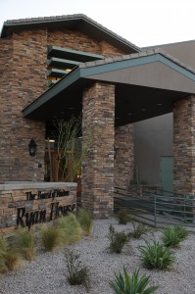
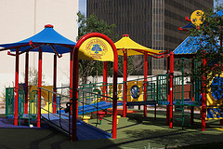
Ryan House Mission
To provide respite and palliative care to children with life-threatening conditions and, as needed, end-of-life care.
Notes:
In the midst of downtown Phoenix, the bright and inviting accessible playground in the back of the house would likely catch your eye first, but inside are many little… and BIG wonders…

Slide 14
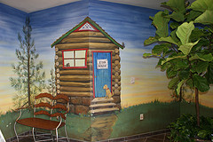
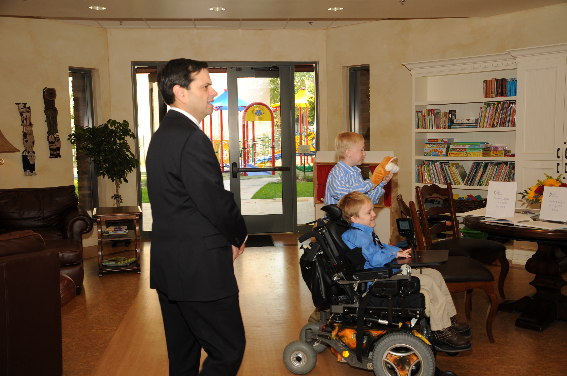
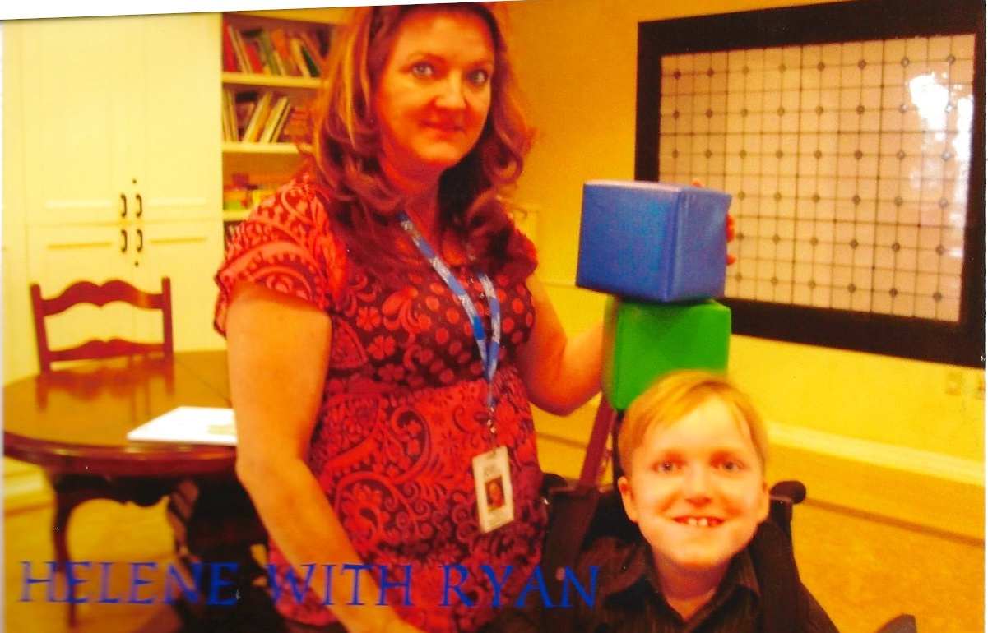
Warm and welcoming
Notes:
From the very front entry, continuing straight into the great room, Ryan House is not only warm and welcoming, but a comfortable home… it’s not uncommon for a parent to say, “This might be called ‘Ryan’ House, but it’s actually ‘Enrique House’ or ‘Sophie House’… and an inviting home for each and every child and family who comes! Even Ryan himself would say, “It’s not “Ryan’s” House – it’s a house for all of us!”

Slide 15
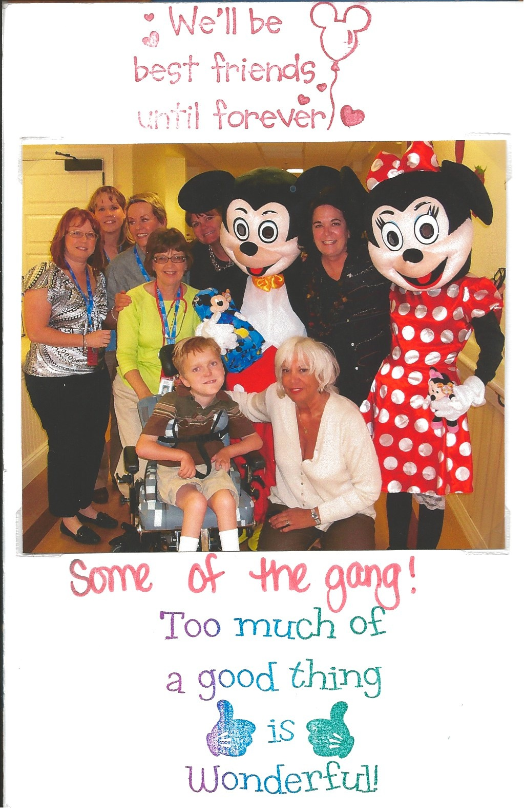
Some of the many
“Little Wonders”
“Be our guest…”
“Be our guest…”
Notes:
Continuing inside, you would quickly notice the complete culture of caregiving! Where children are guests… not patients… and where there are NO scrubs (children see enough of those at appointments and during hospital stays)! Other special guests pay a visit now and then, too…

Slide 16
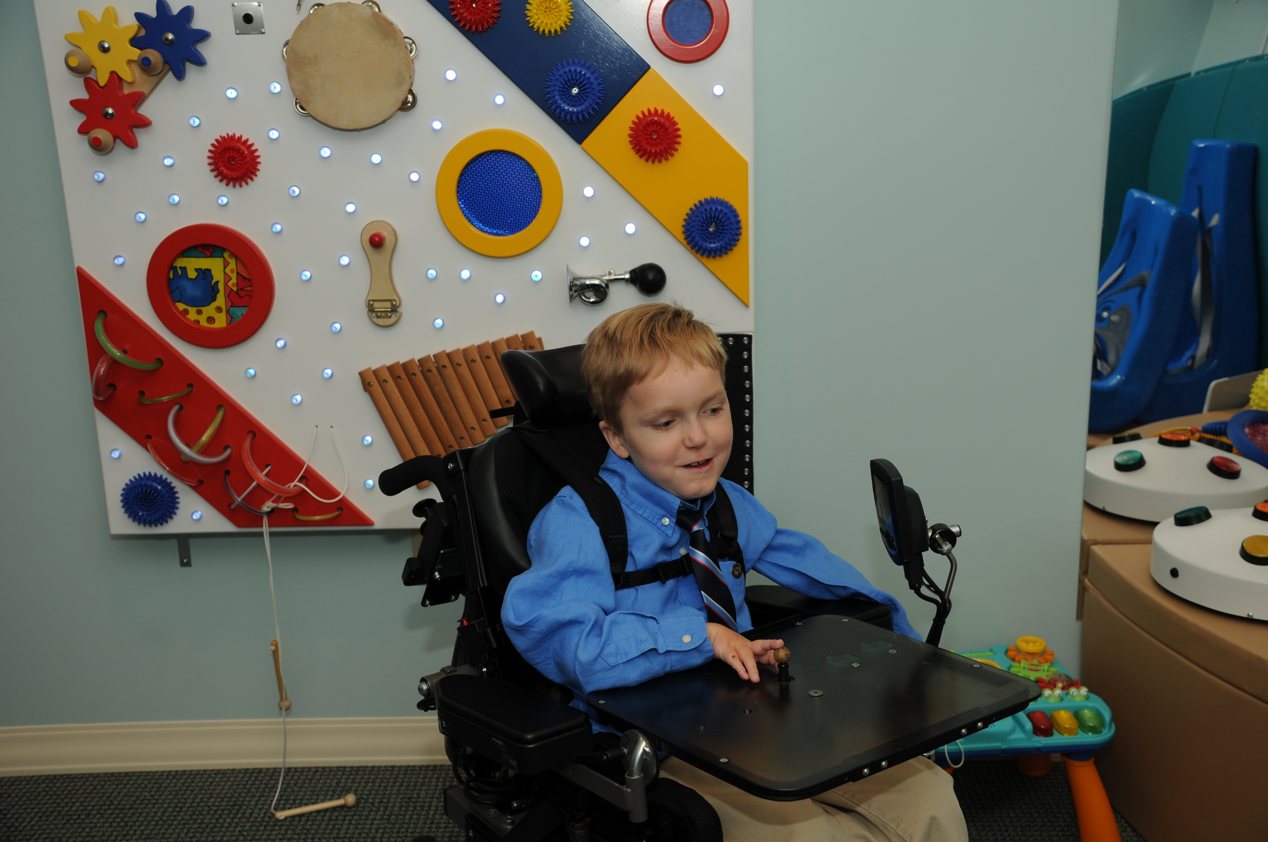
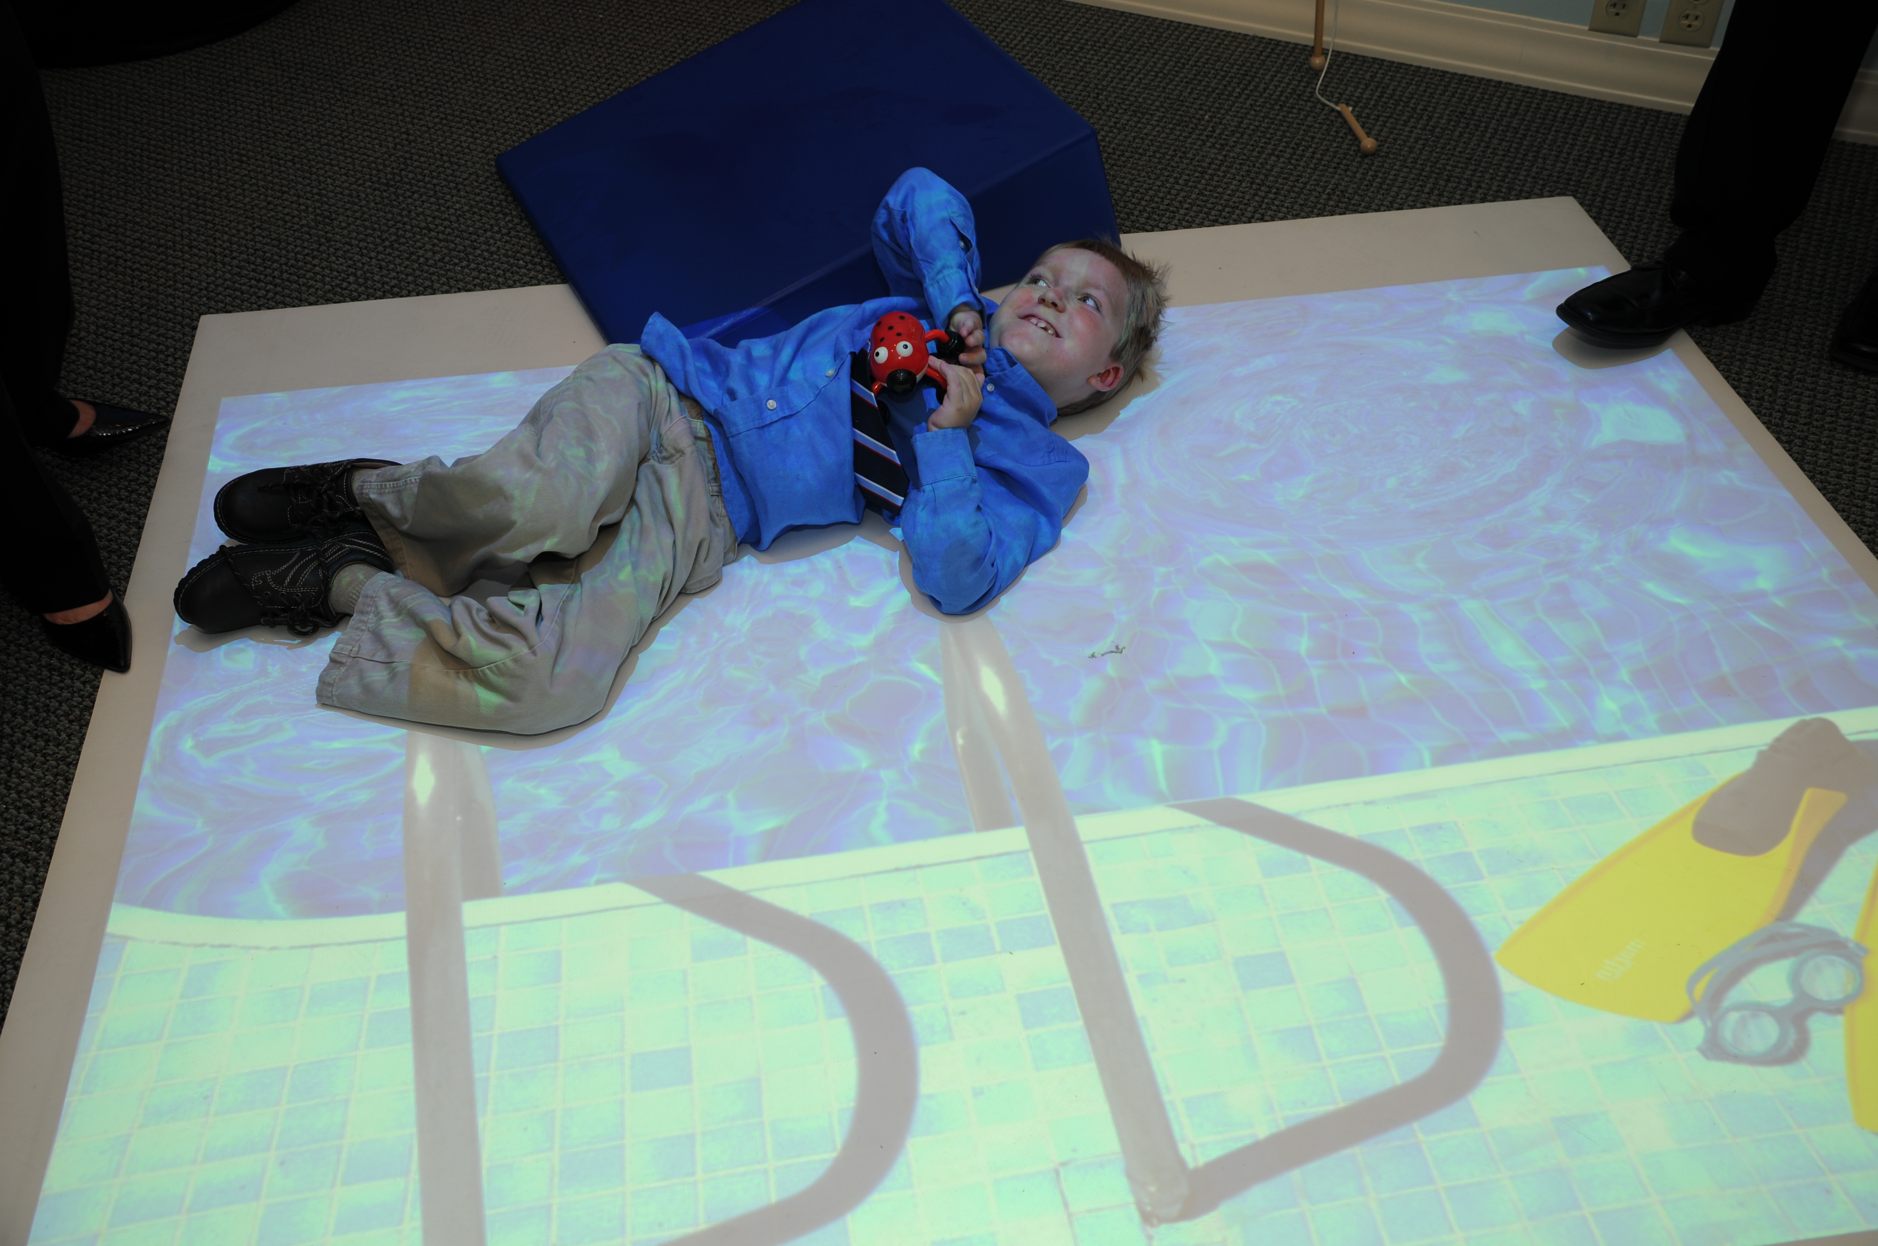
Special experiences
Notes:
Even without those character guests, special experiences abound… one of my favorite’s is the sensory room, where the wave of a hand can cause ripples in a projected pool, fireworks exploding on a dark, starry sky, or even air hockey on the interactive “Gesture tek” screen… but there’s more!

Slide 17
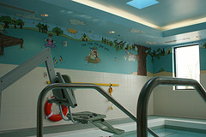
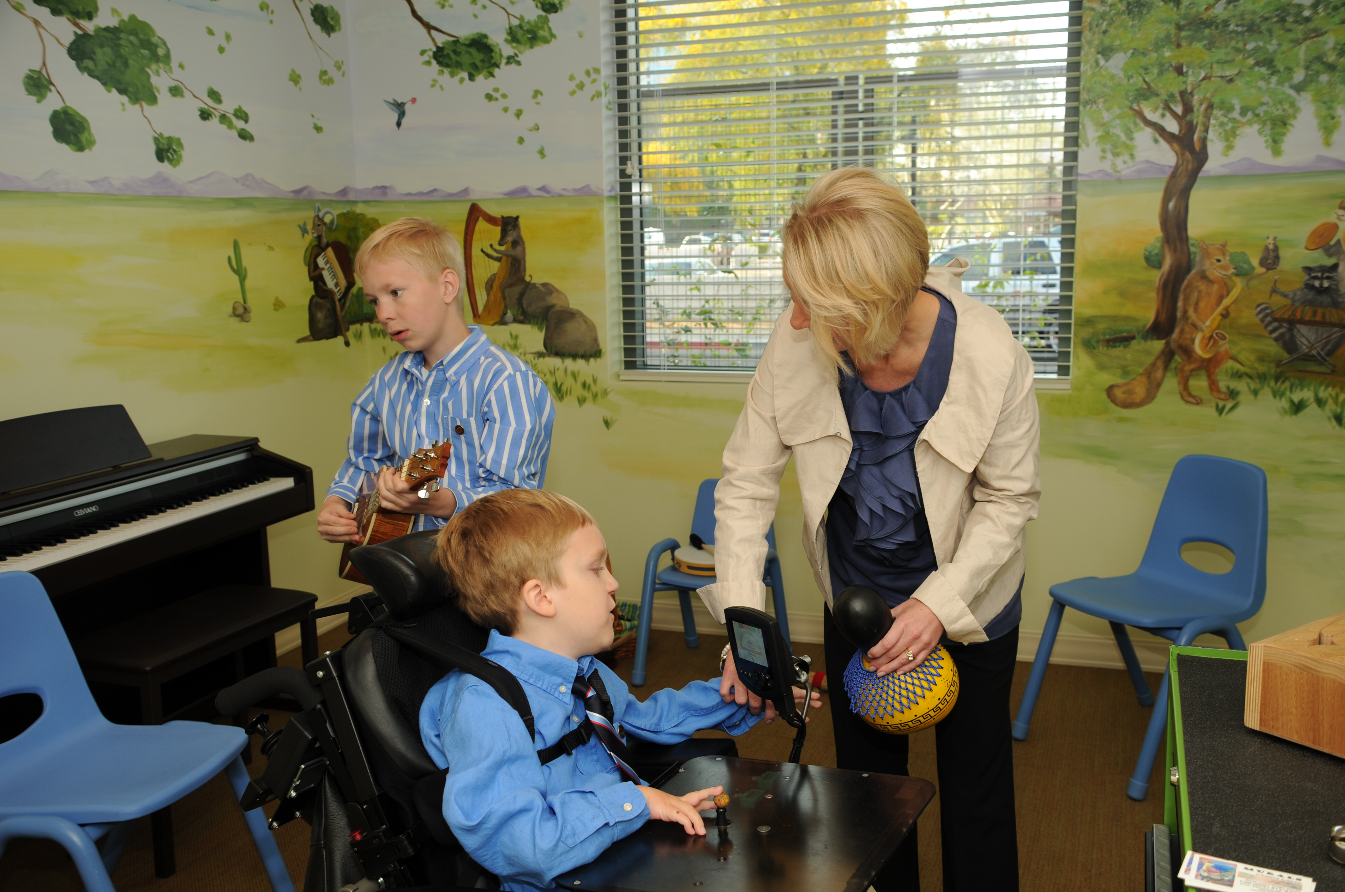
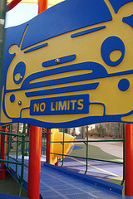
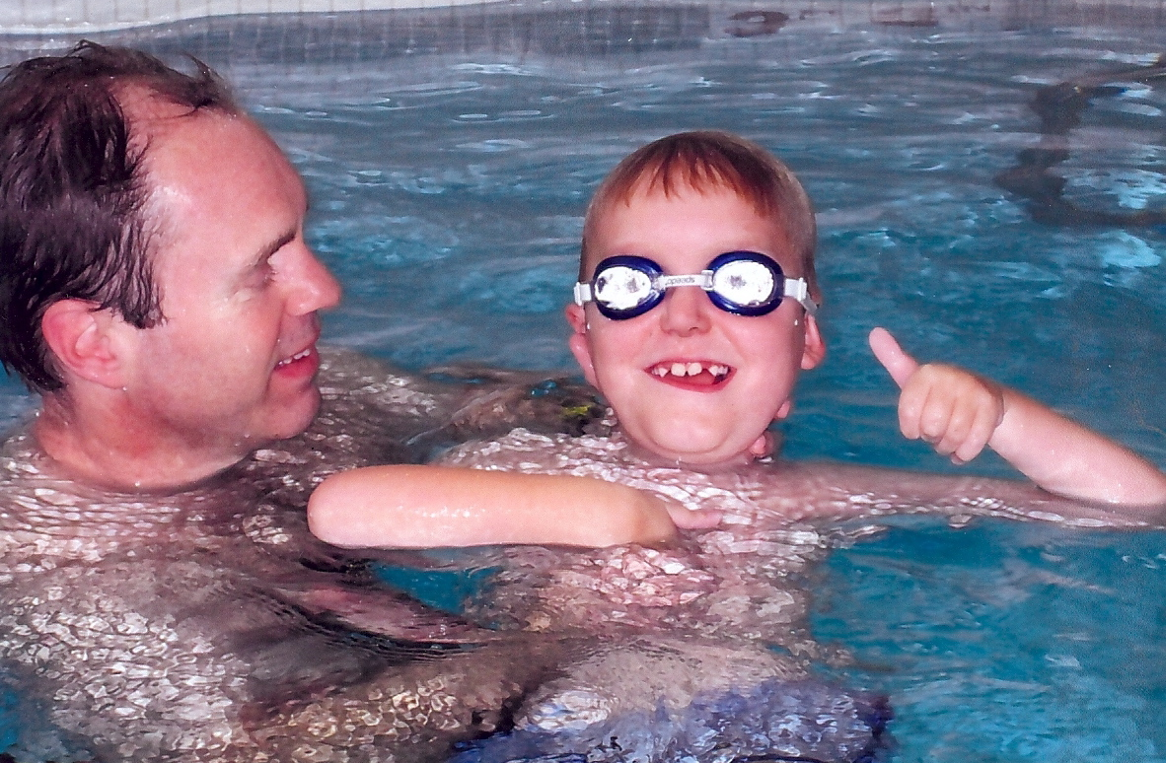
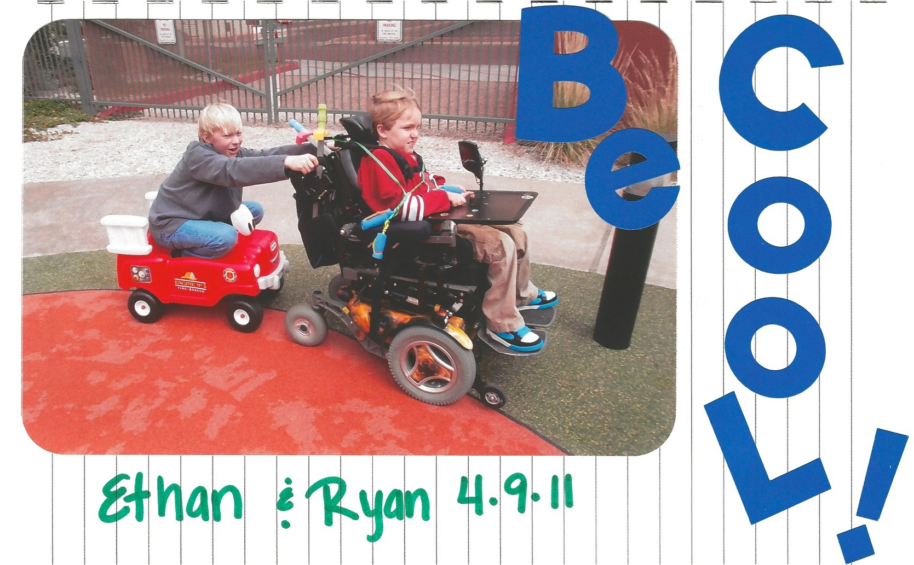
Notes:
Splashing into the warm water hydrotherapy pool can improve circulation, range of motion, not to mention good fun… Music, crafts, play… there are no limits to allowing children to be children first at Ryan House… vs. children with life-threatening conditions.

Slide 18
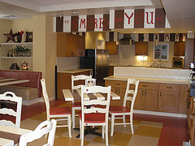
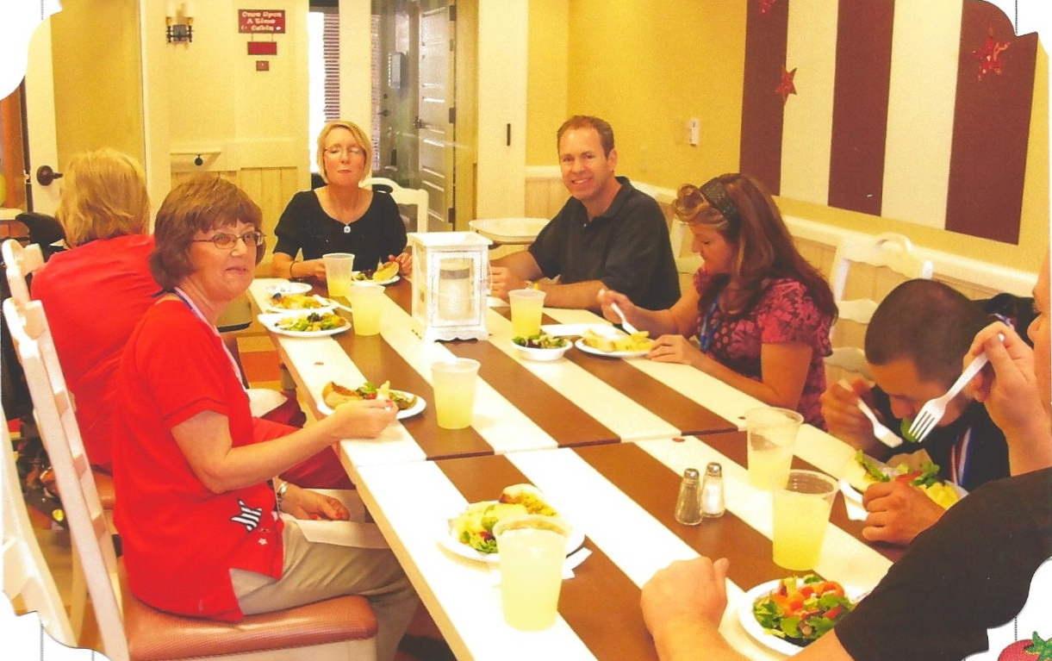
The heart of the home
Notes:
As in many homes, you might find the kitchen at the heart. At Ryan House, families share the kitchen and it would not be uncommon to see a group of volunteers providing a meal for a family and friends… As one of the nurses said, “THIS is Ryan House” and the very best – promoting a home-like culture and a much slower pace…

Slide 19
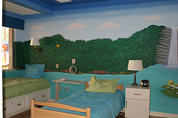
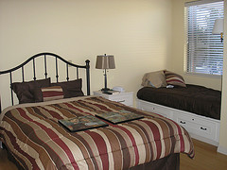
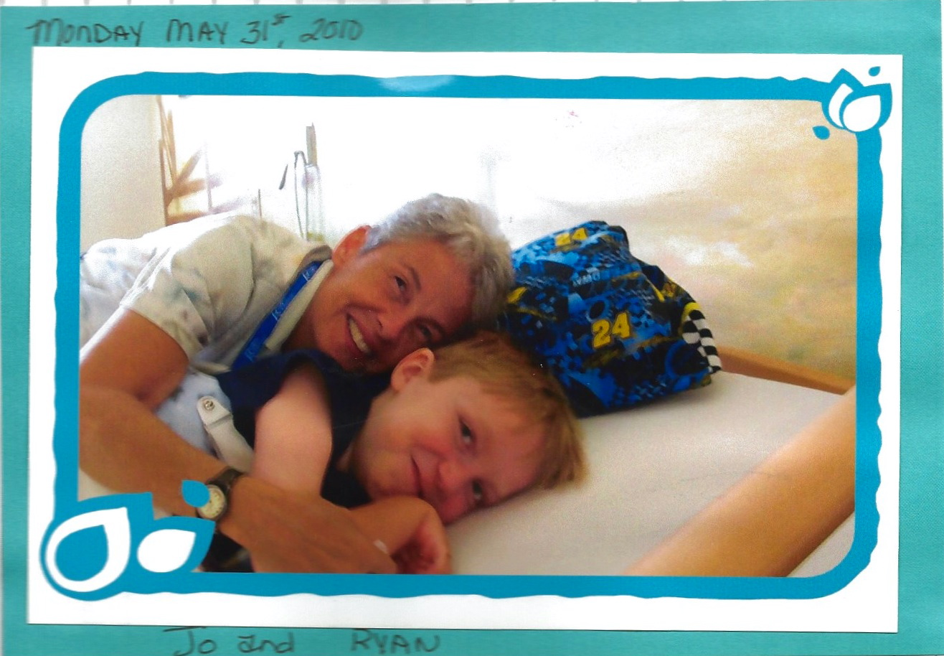
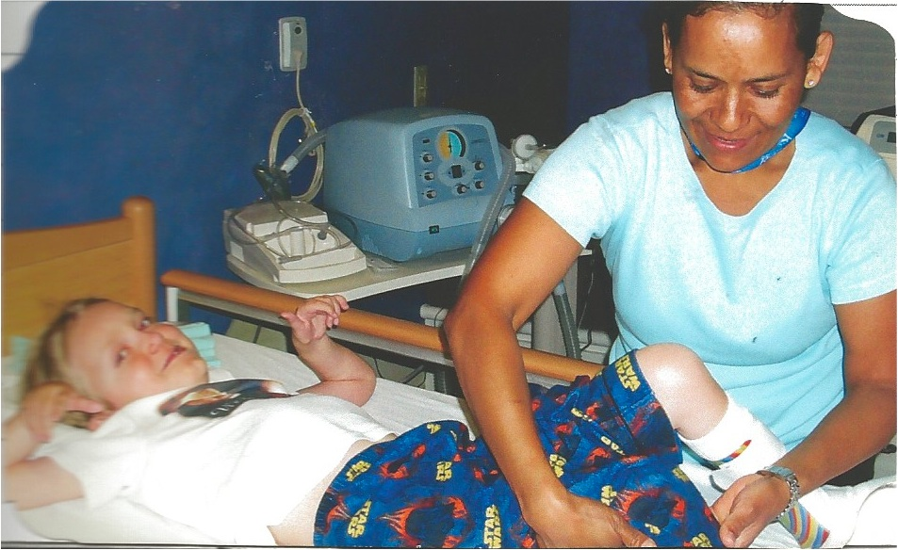
Rest and care
Notes:
Each of the eight children’s rooms and the three family suites allow for a much slower pace as well. Each beautifully themed children’s room has a day-bed, where parents or even a sibling are welcome to stay, but the comfort of a family suite permits parents a rare afternoon nap or, better yet, a full night’s sleep, while knowing that their child is in excellent hands for care…

Slide 20

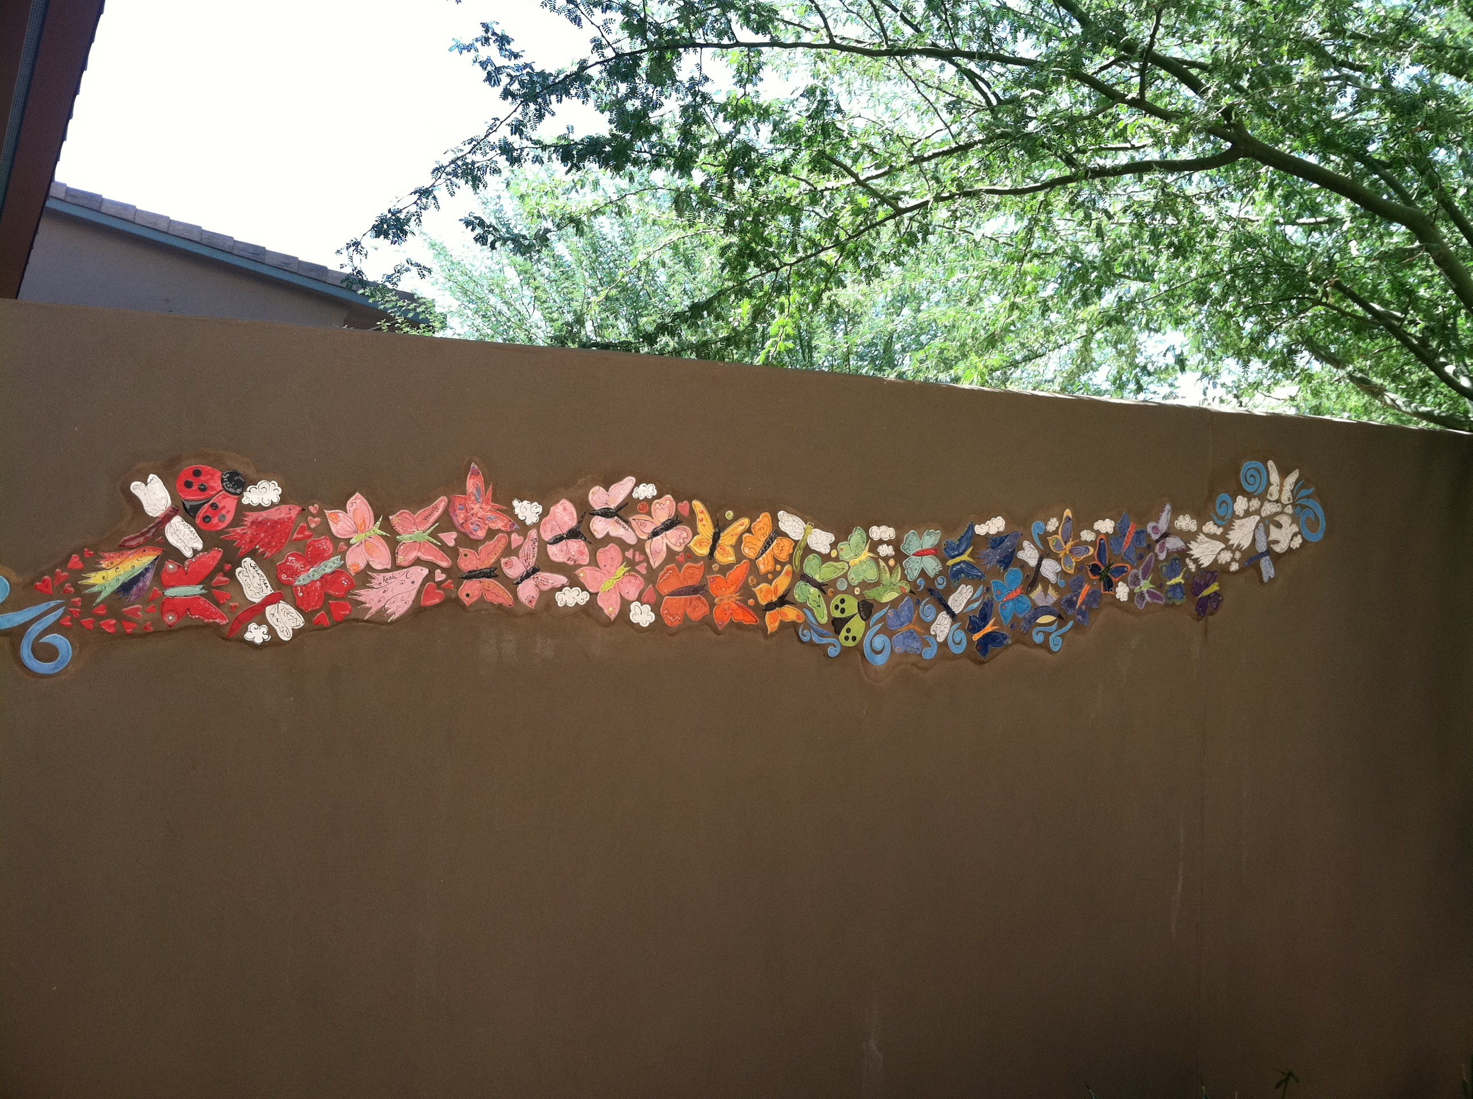
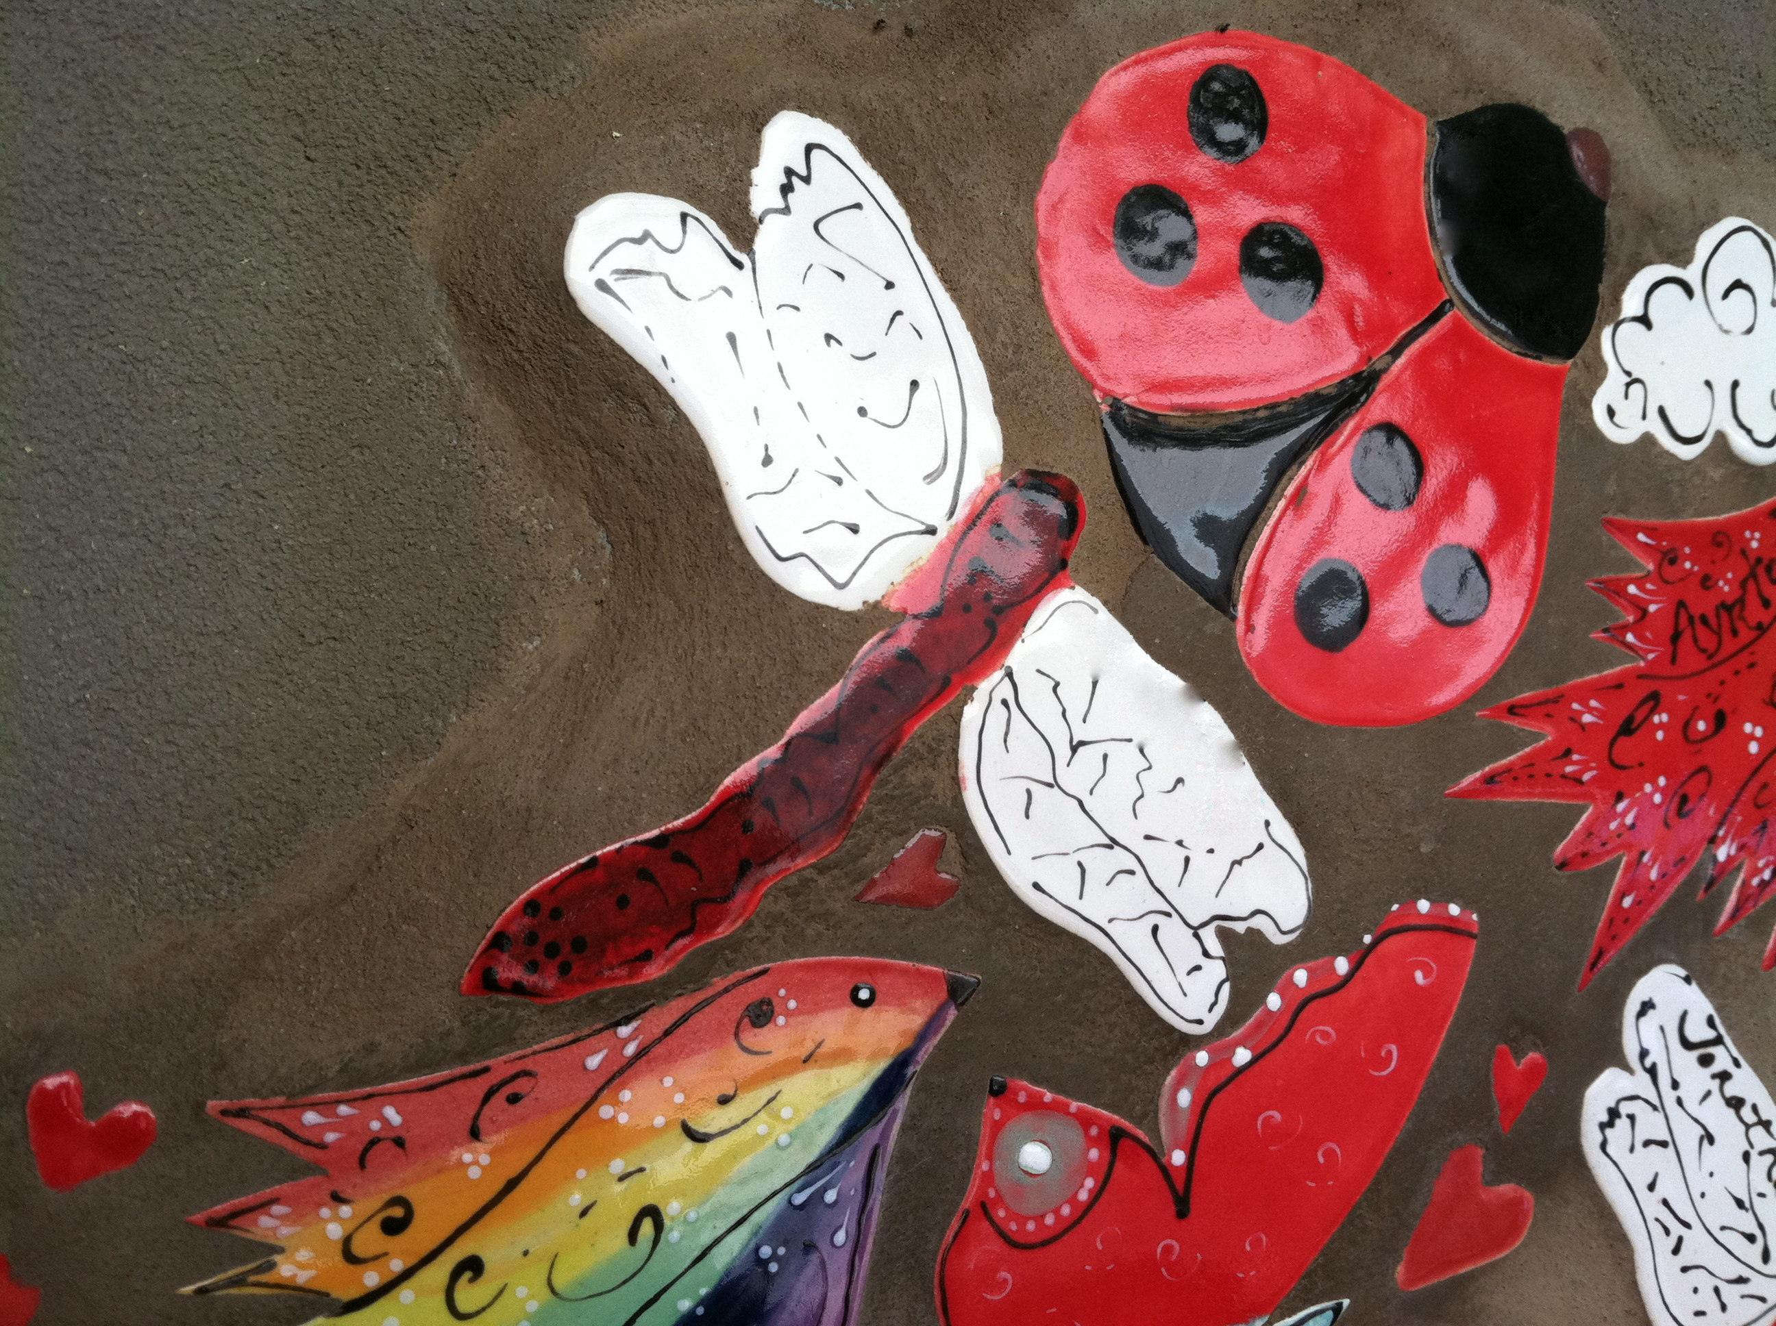
Comfort and connections
Paige
Jacob
Notes:
Even the sanctuary and outdoor garden embody the ongoing comfort and connections available for families – throughout their child’s lifespan and beyond… where families have said, “My child is not alone.”
The beauty of Ryan House extends well beyond the décor and paint, though, with the true beauty in the care that is provided by the exceptional team. Jonathan will now share more about the Care Model and the community network that has provided vital support in its development.

Slide 21
The Care Model
80% of care is short-term respite
  Families receive 28 days per year of planned respite – typically used in 2-10 day stays – at no cost
  Weekends and holidays are rationed – everyone has to “share” the home
End of Life (Hospice) Care is given priority, and then emergency and planned respite needs
We are NOT a babysitting service, nor are we a long-term care facility
Notes:
Now that you’ve taken a “virtual tour” of Ryan House and what you might experience if you were there…, let’s shift gears and share more details on the care model itself and how “respite” is delivered at Ryan House.
Modeled after Helen House and over 45 similar pediatric palliative care homes throughout the U.K., the majority of families utilize Ryan House for planned respite care. Ryan House aims to provide services that are not already available in the community, so it is not intended for daycare or to provide long-term care.
All families need to trust and have confidence in the people that “watch” their children…it’s part of being a parent. When you are a family with a child with a life-limiting condition, it can be even greater. In our family, for instance, our older son is a typical able-bodied teenager at this point. Over the years, it is “normal” for him to have sleep-overs at friends, or stay with an aunt/uncle, grandparent, or have a baby-sitter come to the house to watch him for a short time.
For our younger son, Ryan, there is often the “desire” of people to wish they could watch him for us, but there just is not the expertise and experience for his daily needs to give those people the confidence to be comfortable being responsible for Ryan…even for a short time. How does his breathing equipment work? How do I transfer him to the toilet? What are his medications? How does the wheelchair work? And then, what if he starts to choke? Those are big responsibilities that no one takes lightly.
Just like our experience at Helen House in England, the team at Ryan House provides that confidence.

Slide 22
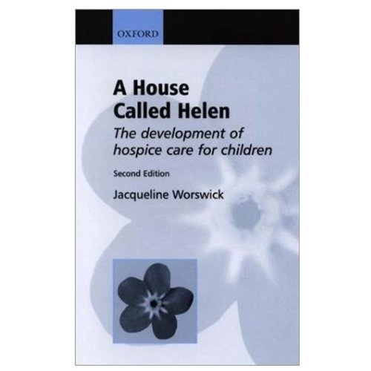
Our Playbook
Notes:
We are fortunate that our our direct experience was with the original, Helen House…it was amazing.
As we began the Ryan House journey, we had our playbook. This book, written by Helen’s mom is a quick read – the first half is the background and Helen’s story, including founder Sister Francis Dominica recognizing the importance of the need – and crafting the concept. It’s a simple concept…friends and family, helping friends and family. Simple and powerful. Lots of hard work and funding to make it happen, but the idea is so simple, relevant, and relatable.
The back half of the book provides a lot of business insights as to how they created and managed the home. Not only did they describe who qualifies, and the struggles with having to say “no” to some families – but it gave us clarity of some very important cultural insights that we’ve adopted at Ryan House.
There are no patients at Helen House…we have guests.
Nurses don’t wear scrubs
These examples became strategic discussion “debates” (I’m being polite) as Ryan House was preparing for opening. These are important distinctions between being perceived as a “medical model” or skilled nursing facility….or what we wanted, consistent with Helen House – a “caregiving model”.
22

Slide 23
Lots of Challenges
Where would we build this? | How will we raise the money? | How will we manage and staff?
How will we sustain it for a long time? | How to involve medical professionals? | Will families come? Will they trust and use the home?
and on…. | and on…. | and on…
Notes:
Our excitement and drive to create Ryan House was often tempered by some very daunting obstacles and challenges we needed to address…
Where would we build it?
How will we raise the money? How will we sustain it? If we don’t have the money, the reality is that Ryan House does not happen.
Including the medical community appropriately.
Building trust and giving confidence to families that they can “entrust” their child to our care.
And on…and on…and on.

Slide 24
We knew we wanted
Available and open to any child and family that qualifies
  Neutral to the community – we respect and will integrate with your existing support network
  No out of pocket costs - not a financial burden to the families – we’re here to help
Establish an operating model that other communities could emulate – if we could do it, so could you!
Notes:
Ultimately, our goal was not to re-invent the Helen House model….but rather, bring it to Arizona.
We knew we wanted to be…..

Slide 25
Community Network
Ryan House
Hospice of the Valley
Kitchell / Orcutt Winslow
Medical Professionals
Community Leaders
St. Joe’s/CHW
Board of Visitors/Junior League
Foundations
Department of Health
Notes:
The phrase we’ve used time and time again to describe the beginning of Ryan House was “the stars were aligned”. It was truly a magical journey that took an exceptional community network to make it happen. It is our hope that by sharing our creation, other communities can develop a vision for the breadth of partners to include to establish a “Helen House” in their backyard.
While the list of Ryan House supporters and contributors is very long, I’d like to feature a few key organizations that “it wouldn’t have happened if…”.

Slide 26
Ryan House
Hospice of the Valley
Kitchell / Orcutt Winslow
Medical Professionals
Community Leaders
St. Joe’s/CHW
Board of Visitors/Junior League
Foundations
Department of Health
Notes:
I want to start with Hospice of the Valley…or HOV.
We are very fortunate to have HOV in Arizona. They are the largest non-profit Hospice in the country with over 1,700 employees + 2,200 volunteers and 18 in-patient homes around the valley.
When the Helen House concept was first discussed, the Cottor’s never intended to do this ourselves. Through family friends, Holly met with Susan Levine the Executive Director…a truly amazing community leader and shared our experiences and desire for them to do such a concept here in Phoenix. Susan was intrigued…HOV had a pediatric program and team, but not a free-standing home and respite was not a focus. She wasn’t sure it was an immediate fit, but wanted to stay close and help see how it develops.
Whenever we needed meeting space – HOV was there. Allowing us to host community meetings and information sessions. And eventually allowing us to house a small Ryan House team in a section of their building.
When we were ready to hire our first Executive Director…we didn’t have more than a few months salary in the bank – Susan/HOV gifted us $25,000…and told me there’d be another $25,000 if we needed it. We never did.
HOV has always had Ryan House under their caring wing…watching and helping us along. When we incorporated and formalized our board, Susan herself joined on.
A few years ago, during our capital campaign for the $6.5 Million building funds, Susan boldly stated that HOV had been impressed with how we all had developed this concept. And that they believed so much in what we were doing that they were going to pay for the entire building (that’s $6.5 Million) – and that the money we had already raised…keep it, and put it towards operations to make sure we can sustain the project. What they wanted in return was to put a second story on the building and house a 12 bedroom “hospice” home.
I’ll be honest, I was quite nervous about a second story…would this turn Ryan House into a 20 bedroom hospice home? No, the reality is a beautifully designed multi-generational home. When you come into the vestibule, are you going upstairs or straight-forward into the pediatric palliative care home – there is a clear distinction. This is 2 concepts co-existing on the same footprint. We get building efficiencies. Our Team Leader, Pam, is a pediatric passionate RN who heads up downstairs and also oversees the operations upstairs so there is that efficiency as well. But other than Pam, the teams are separate.
It’s not that the two groups can’t interact – the upstairs has beautiful grand balconies – and how nice is it for the hospice patients upstairs to hear the laughing and playing of children in the playground down below?
Not only did they contribute significant capital funds to make this dream a reality, but they opened up their business to us…we created an integrated partnership between the 2 organizations. I’ll tell you a bit more about the team structure in a moment, but the overarching idea is that Ryan House is still it’s own 501c3 non-profit. Our amazing board raises a lot of money each year and has oversight and responsibility for the pediatric Ryan House floor. All of our team are technically HOV employees which allows us to leverage big company benefit programs and infrastructure needs. The entire building is “Ryan House”. The brand Ryan House is associated with the pediatric program.
And the real beauty of the upstairs and the long-term vision of how this will further evolve is that upstairs becomes an opportunity to extend this model to the 18-45 year olds. Kids don’t die on a timetable….when a child become 17, 18 , 19 or older, Ryan House really isn’t a fit for them any longer. But a family may have been coming to Ryan House for years….upstairs is where that continuity of care will be able to continue. Helen House has recognized this and years ago built Douglas House to do just that on the same property. We have that pre-built into Ryan House already and just need to let this model mature a bit to get there.
There are a number of “it wouldn’t have happened if” moments and groups in Ryan House’s history…HOV is definitely one of them.
26

Slide 27
Ryan House
Hospice of the Valley
Kitchell / Orcutt Winslow
Medical Professionals
Community Leaders
St. Joe’s/CHW
Board of Visitors/Junior League
Foundations
Department of Health
Notes:
I tell everyone I can that Ryan House is NOT a medical model. It is NOT a nursing model. It IS a Caregiving Community Model. A major key to the success of Ryan House is it’s deep connections with our Community. That thankfully began right at the beginning with the amazing introduction to Judy Schubert, and the Board of Visitors. The Board of visitors is the oldest charitable organization in Arizona, and a wonderful group of women committed to making a difference. Another “stars aligned” moment was meeting Judy and her BOV committee who was actively seeking a non-profit to embrace as the beneficiary of their annual “Care Card” program. It was the perfect meeting, at the perfect time. Judy Schubert, Judy Shannon, and Susan Palmer-Hunter were immediately connected to the idea of the Ryan House concept. Ryan House was “new” and needed. It was exciting to to create something from the beginning, and it was a project that the Board of Visitors could join forces with the Junior League of Phoenix on…which an important element that they were also looking for. The Junior League of Phoenix is another amazing group of young woman that has tremendous reach across the Phoenix Valley. Many of the Junior League woman go on to become Board of Visitors members – and Ryan House became a perfect project to facilitate leadership conversations between those two organizations.
For Ryan House to become a “community organization”, we couldn’t have had a better beginning. The Board of Visitors and the Junior League of Phoenix created our awareness, and more than supported Ryan House, they fully embraced it. The worked tirelessly to turn a concept into a legitimate program. The dedication of these women made it happen. The Care Card annual shopping card program was HUGE for Ryan House. It generated contributions for Ryan House of over $100,000 a year in the early years and collectively has benefitted Ryan House by over $1 Million dollars. That is why the Board of Visitors is proudly recognized as the lead Community organization for the brand “The Board of Visitors Ryan House”. For a community led organization, we couldn’t be more pleased and thankful.

Slide 28
Ryan House
Hospice of the Valley
Kitchell / Orcutt Winslow
Medical Professionals
Community Leaders
St. Joe’s/CHW
Board of Visitors/Junior League
Foundations
Department of Health
Notes:
Where to build Ryan House? The English “Helen House” model and the 40+ home like it in the United Kingdom are peaceful, restful places. The English like their gardens, the ground are beautiful at Helen House.
I mentioned Judy Schubert in my last slide. She is so instrumental in the creation of Ryan House that I’ll be mentioning her more. At this moment in time, her husband Bill Schubert happened to be the President of the St. Joseph’s Hospital Foundation. Judy knew that St. Joseph’s hospital had a parcel of land that was being explored for a Ronald McDonald House, but that a decision was made to locate the Ronald McDonald Hose on the Phoenix Children’s Hospital campus. St. Joe’s had a thriving pediatric program, and so in-steps the idea of Ryan House…a perfect fit in the eyes of Linda Hunt, St. Joseph’s CEO.
From Ryan House’s perspective, we were thrilled, but also had 2 concerns to address. First, our goal was also to be available to all Arizona famlies regardless of who their medical professional support was. We were nervous that accepting the land from St. Joseph’s would mean that we would become a “St. Joseph’s Project”, and that families that went to other medical centers like Phoenix Children’s Hospital or Banner’s “Cardon Center” in Mesa may not have access. The other concern was space. While the land offer was incredibly generous, and the location is ideal…very centrally located in Phoenix with access to lots of community experiences and highway access for famlies…the reality is the land itself was “small”. What about the English garden spaces?
Linda Hunt and St. Joseph’s, and their parent organization Catholic Healthcare West, are amazing community leaders. They were committed to helping Ryan House become a reality…their land offer was “no strings attached”. Literally…here’s the land, a 60 year lease for a $1 a year…and Linda said she’d pay the dollar. Anything they could do to help. This was not to be a St. Joseph’s project, they were just a benefactor…wow!
On the second issue of land size….how could we build the building, have parking, and space for gardens? Don’t’ worry about that…they gave us more parking with the lot next door so we could maximize the plot of land for the building. Again, talk about Stars aligned…if Ryan House had been earlier or later, that land would have gone to other uses.
Today, St. Joseph’s has integrated much of its pediatric program with Phoenix Children’s Hospital right down the road. We have fantastic relationships with both organizations, and others…and life it good!
When land became available…it put this project is a much more significant scale. It legitimized what we were doing, and made us work even harder. Thankfully it happened so early in our development.
28

Slide 29
Ryan House
Hospice of the Valley
Kitchell / Orcutt Winslow
Medical Professionals
Community Leaders
St. Joe’s/CHW
Board of Visitors/Junior League
Foundations
Department of Health
Notes:
How do we open a facility “home” like this in Arizona (and the United States?). How do we provide the respite care and breadth of palliative care support these families need within the existing licensing boundaries.
I wanted to quickly share highlights from discussions we had early on with the Department of Health. They “got it” – and were extremely supportive of this new care model for Arizona.
One memorable meeting they assembled a roomful of directors – literally the head decision makers from every relevant department. The purpose was to explore what may work, or what would definitely not fit.
- Daycare centers – wouldn’t cover the robustness of our medical issues
Skilled Nursing – too constricting in terms of nurse to patient (in our case, “guest”) ratios – we would be over-burdened with salaries. Most moms and dads aren’t nurses.
Hospice – would be great, but one requirement was “outreach” – something our model does not provide. Families and children come to Ryan House.
The conclusion at the time was “Unclassified Facility”. This kind of sounds like a cop-out, and what is it really? Actually, if we would have not eventually developed our integrated partnership with Hospice of the Valley (HOV) – this would have been our route.
The Dept of Health would consider Ryan House “Unclassified” – which means they understand that this model does not fit into an existing definition of care. That they would help us document what we do, and then hold us accountable to that.
There are 6 other facilities in Arizona that are “unclassified” in other regards for the types of work they do.
This would have been very positive in the sense that we could do what we wanted and needed to do.
The downside is that the insurance carriers and Medicaid don’t recognize it as a license – and therefore there is no reimbursement.
Well, in reality “Respite” in our type model is not reimburseable today anyway. Our long-term strategy has always been and is to build a case-study for why this type of care is so needed, and “medically necessary” (to use insurance language) so support reimbursement. We have conversations ongoing with major insurance carriers and Medicaid on this now (that’s an advantage Arizona has is that our state is smaller and we have access to key decision makers).
In the meantime, we raise money. Lots of it…thankfully we have an amazing team and are very good at it.
29

Slide 30
Ryan House
Hospice of the Valley
Kitchell / Orcutt Winslow
Medical Professionals
Community Leaders
St. Joe’s/CHW
Board of Visitors/Junior League
Foundations
Department of Health
Notes:
Ryan House was my first non-profit experience. This is a mission I am deeply passionate about, and it drove me personally to work hard to turn this into reality not only for our family, but for all of Arizona Families. One lesson I learned early on….it takes money to make it happen! Lots of it!
Thankfully we had leadership involved with our group, like Judy Schubert and others, that coached me on the focus of raising money. Many times I wanted to talk about the mission and services, and was reminded that we needed to stay focused on fund-raising or it wouldn’t happen. Frustrating at times, but so true. It is the advice I pass along to the emerging projects I speak with now.

Slide 31
Ryan House
Hospice of the Valley
Kitchell / Orcutt Winslow
Medical Professionals
Community Leaders
St. Joe’s/CHW
Board of Visitors/Junior League
Foundations
Department of Health
Notes:
. It involved construction – which was also a passion of Judy Schubert’s as her husband Bill happened to be the CEO of Kitchell Contractors
Kitchell Contractors is one of the Valley’s major builders, and likes to be involved in one non-profit project.
At this moment in time, Kitchell had just finished up the Southwest Autism Research Center (SARC) and was looking for the next project.
Had we been 1 year earlier, or 1 year later, this Kitchell connection would have been missed.
It was through the Board of Visitors that connections were made with Orcutt Winslow, a major architectural firm in town. They believed in the Ryan House vision and dramatically reduced their fees to be invovled.
31

Slide 32
Ryan House
Hospice of the Valley
Kitchell / Orcutt Winslow
Medical Professionals
Community Leaders
St. Joe’s/CHW
Board of Visitors/Junior League
Foundations
Department of Health
Notes:
Ryan House is a caregiving Model, not a medical one. That said, the medical community is incredibly important to Ryan House families for sure. To qualify for Ryan House, the child has been diagnosed with a life-threatening condition and with that comes complicated medical issues. When Ryan House children and families come to the home for respite stays, it is an extension of their home. Yes these children are not expected to live long lives, but they are not sick. If they were sick, they need to go to the hospital not Ryan House. But like in their own home, they may become sick. Or the parents, or children may have questions or want to discuss topics that are best handled by a doctor.
Let me share a quick story about our Helen House experience. It is at Helen House that I learned about death. And it was a conversation with the medical director there that gave me confidence that I would be able to identify when that path begins for Ryan. When Ryan was diagnosed, one of the scariest thoughts I had in those early months was “please don’t die on my watch”. I was panicked with the idea that Holly would go for a quick dinner with her friends to get a break and I would be left alone with my son Ryan. For a dad to be scared to be alone with his son, really hurt. While we had many medical professionals around, including my own dad who is an MD and Child Psychiatrist and my mom who is a Psychotherapist…the one person I connected with on this topic was a doctor at Helen House. In a calm and peaceful moment, we had a very caring conversation that helped me understand how to trust my own eyes. That I would recognize when Ryan’s body was starting to give out, and he was on a path to death. Holly and I talked a lot about allowing nature to take its course…and that if Ryan, on my watch, was choking on a cheerio…that was not nature taking it’s own course, that was choking…and get the cheerio out.
Did it have to be the doctor that had that conversation with me? I don’t know, but it was the right conversation at the right time.
What we do want at Ryan House is to recognize the importance of the medical professionals in the lives of our families. We want to assure that Ryan House is open to any Arizona family that qualifies, and that the medical professionals that support those families are valued and welcome. We have a part-time medical director. And there are always RN’s in the house at all times. When a child comes to stay at Ryan House, they are still under the umbrella of care of their primary medical team…the Ryan House team connects with them regularly and makes sure the lines of communication are open. There is no “hand-over” to the Ryan House team and back.
To achieve this, we also established a “Medical Advisory Council” early in Ryan House’s development with pediatricians passionate about pediatric palliative care. Medical professions that share that passion are always welcome to connect and join that council to provide their voice and expertise to the Ryan House team.
32

Slide 33
Ryan House
Hospice of the Valley
Kitchell / Orcutt Winslow
Medical Professionals
Community Leaders
St. Joe’s/CHW
Board of Visitors/Junior League
Foundations
Department of Health
Notes:
Here I would like to broadly recognize all the countless others that contributed and supported Ryan House…and continue to do so.
Our Board is amazing, and filled with Community leaders.
Ryan House is successful because of our community.
33

Slide 34
Ryan House
Board of Directors
RH Board Chair
Director of Inpatient Services
Executive Director
Medical Director
Team Leader
Clinical Resource Coordinator (Programs)
Communication
Coordinator
Development
Director
Community
Liaison
RN/ LPN
CNAs
Child Life Specialist
Enrichment Therapists
Social
Worker
Chaplain
Notes:
Here is an overview of our organizational model. When visitors come through the home for a tour, they are in awe of its beauty and home-like warmness available to the families that stay. The building itself is fantastic…but it’s the care team that creates the trust and confidence for families to utilize our services. It is the combination of building and care-team that is Ryan House.
Approx. 20 staff , and over 100 volunteers - $1.6-1.8 Million annual operating budget.
We have an RN in the building at all times – most, if not all, of the kids have medications. So licensing and many parent comfort levels require an RN presence. But the staff is holistic…everyone has a primary responsibility and role, but everyone works together.
We don’t have a cook for instance – that’s shared just like a kitchen at home.
Our Medical Director is “part-time” and available as needed. Either to liaise with a child’s primary care team as needed, or for conversations and consultations as required. We have an active Medical advisory committee that stays close to the care team
This is the team that delivers respite and our services.
34

Slide 35

Globally
Helen House opened November, 1982
8+
1
40+
2
2
Notes:
This model of care began with Helen House, and in the next 30 years over 40 similar homes have opened in the United Kingdom. The UK is 1/6th the size of the US, and wouldn’t it be great if the US had 240 of them? So far, only 2…GeorgeMark Children’s Home in the Oakland area, and Ryan House in Phoenix. Both of these homes were inspired by the UK model.
Our neighbors to the North (Canada) have at least 8 homes open…this is a country 1/10th the size of the US.
Why are there not more in the US? Well, I can tell you from our Cottor experience, Holly and I experienced the best of both worlds. In the US, our attitudes are “children don’t die…we save kids”…which means that many parents and children have pursued treatments and cures to the final moments of life – often times missing out on maximizing the life that the child did have.
In the UK, the cultural attitude is more “death is a natural part of life”. A big distinction. There, the emphasis is on maximizing the quality of life, recognizing that it may be a short life.
Obviously, as Americans…we want nothing more than to find a cure for Spinal Muscular Atrophy (SMA), and we also spend lots of family energy towards that goal. But because of our England experience, we are emphasize “quality of life”…we truly seek out experiences that help Ryan’s life be the fullest it can be.
Ryan House – not only provides Holly and I “respite” we so desperately need from time to time. But Ryan has such a fun time there. It is the total experience of pediatric palliative care that helps our family so much.

Slide 36
U.S. Expansion
George Mark Children's Hospice, opened March 2004 in California
Ryan House, opened March 2010 in Arizona
Dr. Bob's Place, opened in 2011 in Maryland
Sarah House, in development in Ohio
Connor's House, in development in Philadelphia
Children's Lighthouse of Minnesota, in development in Minnesota
Notes:
There is momentum. The great news, as I was checking the status…I believe Dr. Bob’s Place may actually be open now. There are a number of groups that have formally organized and are pursuing projects in their communities.
I hope we’ll be able to add more to this list….from your community as well!

Slide 37
At a glance…
Provided over 34,000 care hours in the first year alone
  22 children died at Ryan House
Currently 115 families actively scheduling at Ryan House
Hospice of the Valley
  75 families receiving pediatric palliative homecare
  25 children on hospice
Notes:
Ryan House opened a little over a year and a half ago and the number of children and families who benefit from care continues to grow.

Slide 38
A lifeline of hope, courage, love, care, & friendship
“I don’t know what I would do without Ryan House. I don’t know how I did it without it.”
“Ryan House has given me the security and confidence to go forward.”
“It’s such a precious resource. It’s humbling that there is a community that donates its time and money to help us.”
Notes:
Ryan House is having such a positive impact for these families. Having quality respite available is vital, and gives a momentary recharge to keep moving forward.

Slide 39
Thank you!
  Keep pediatric respite programs top of mind!
  Recognize your community’s potential
  Take action in your community
Notes:
CLOSE WITH “LITTLE WONDERS” VIDEO.

