Slide 1
Office for Children with Special Health Care Needs (OCSHCN)
Many Faces Respite Conference
November 2 – 3, 2011
Glendale, Arizona

Slide 2
Vision
All children and
youth with
special health
care needs have
the opportunity to
reach their full
potential.
Mission
To continuously
improve comprehensive
systems of care that
enhance the health,
future and quality of
life for children and
youth and their
families.

Slide 3
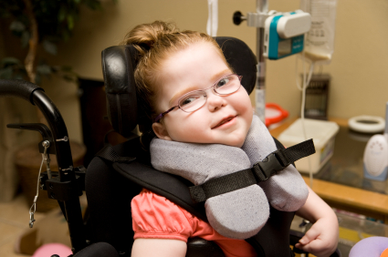
Definition of children with special health care needs (CSHCN)
Children with a chronic physical, developmental, behavioral, or emotional condition, and
Who require health and related service beyond those required by children (birth – 21 years old) generally.
Defined by the U.S. Department of Health and Human Services, Health Resources and Services Administration, Maternal and Child Health Bureau (MCHB)

Slide 4
OCSHCN
Title V Maternal Child Health Block Grant
Promotes Best Practices
Family-Centered
Culturally Effective Care
Family and Youth Involvement
Transition to Adulthood
Medical Home
E-Learning & Telemedicine

Slide 5
OCSHCN Priorities
Educate families, providers and child-serving agencies on eligibility rules and processes for accessing services
Increase access to available and appropriate services for children and youth with special health care needs
Increase recognition of families as integral partners in care of their child’s health and well being

Slide 6
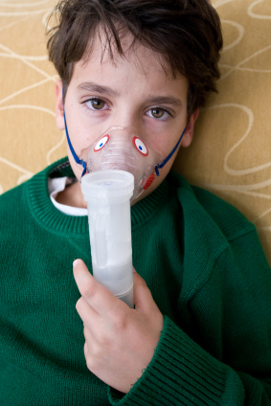
OCSHCN Resources
Care coordination tools for CYSHCN
Training
Parent and Youth Leadership
Breaking the Diagnosis
Communicating with Physicians
Resiliency
Cultural Competency
Values, Beliefs and Attitudes
Disability Awareness and Sensitivity
Diversity of Families

Slide 7
Call OCSHCN . . .
Because every issue changes when you consider including children with special health care needs
Childcare
Mental/behavioral health
School policies
Obesity campaigns
Injury prevention
Advanced directives and end of life decisions

Slide 8
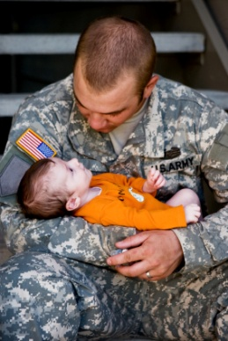
Cultural Competence:
An exploration of Values, Beliefs and Attitudes

Slide 9
Culture
The integrated pattern of human behavior that includes thought, communication, actions, customs, beliefs, values and institutions of racial, ethnic, religious or social group.

Slide 10
Cultural Competence
An awareness and appreciation of customs, values and beliefs and the ability to incorporate them into assessment, treatment and interaction with any individual.

Slide 11
How Personal Values are Formed
Family and childhood messages
Lifestyle
Age
Geographic location
Religious education
Formal schooling
Peer groups

Slide 12
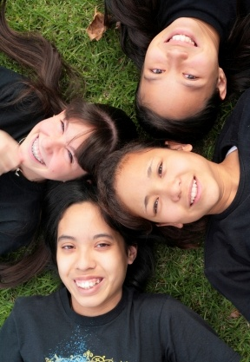
Values – Group Activity

Slide 13
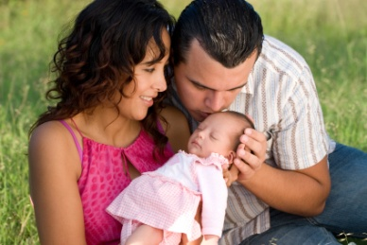
Examples of Values
Money
Tradition
Self-Reliance
Success
Religion

Slide 14
Office for Children with Special Health Care Needs
Bureau of Women’s and Children’s Health
Arizona Department of Health Services
150 N. 18th Avenue, Suite 320
Phoenix, AZ 85007
Tel: 602-542-1860
Fax: 602-542-2589
Toll Free: -8000-232-1676
OCSHCN@azdhs.gov
http://www.azdhs.gov/phs/ocshcn/index.htm

Slide 15
Questions?

